Slide 1

Green University of Bangladesh
Department Of Computer Science and Engineering(CSE)
FACULTY OF SCIENCE AND ENGINEERING
Course Title:Introduction to Electrical Engineering Lab
Course Code: EEE-202 Section: DG
Course Instructor:
Abir Kallayan Abedin
Lecturer
Green University of Bangladesh

Slide 2





Our Team Members
Md. Zahidul Islam
Md. Abu Saeid
Md. Mahim Hossain
Md. Sahid
ID: 221902091
ID: 221902092
ID: 221902082
ID: 221902057

Slide 3

TABLE OF CONTENTS
Introduction
Thevenin Theorem
Works Steps
Real life application
Familiarization with alternating current (AC) waves
How it works
Real life application
Conclusion

Slide 4



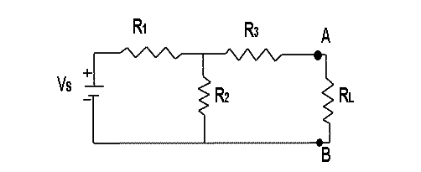
INTRODUCTION

Slide 5
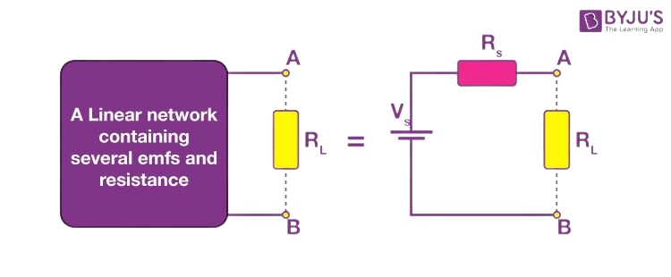
Thevenin Theorem
Thevenin Theorem states that it is possible to simplifi any linear circuit,errespecive of how complex it is, to an equivalent circuit with a single voltage source and a series resistance.

Slide 6

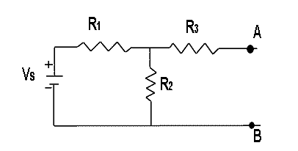
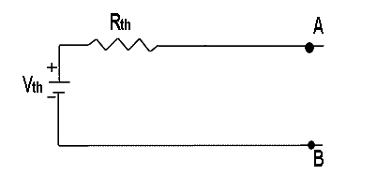
Work Steps:
Find the Thevenin Resistance by removing all voltage sources and load.
Find the Thevenin Voltage by reconnecting the voltage sources.
Use the Thevenin Resistance and Voltage to find the total current flowing through the load..
fig : 1
fig :2
fig : 3

Slide 7

REAL LIFE APPLICATION
Analysis of power systems.
Source modelling and resistance measurement using the Wheatstone bridge.

Slide 8

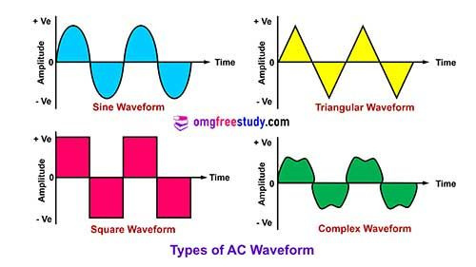
FAMILIARIZATION WITH
ALTERNATING CURRENT (AC) WAVES
Alternating current (AC) is an electric current that periodically changes direction.

Slide 9



